Slide 1
Overview
Register Transfer Language
Register Transfer
Bus and Memory Transfers
Arithmetic Micro-operations
Logic Micro-operations
Shift Micro-operations
Arithmetic Logic Shift Unit

Slide 2
ARITHMETIC MICROOPERATIONS
The basic arithmetic microoperations are
  Addition
  Subtraction
  Increment
  Decrement
The additional arithmetic microoperations are
  Add with carry
  Subtract with borrow
  Transfer/Load
  etc. …
Summary of Typical Arithmetic Micro-Operations
  R3 ← R1 + R2 Contents of R1 plus R2 transferred to R3
  R3 ← R1 - R2 Contents of R1 minus R2 transferred to R3
  R2 ← R2’ Complement the contents of R2
  R2 ← R2’+ 1 2's complement the contents of R2 (negate)
  R3 ← R1 + R2’+ 1 subtraction
  R1 ← R1 + 1 Increment
  R1 ← R1 - 1 Decrement

Slide 3
ADDER
Adder is used for arithmetic addition operation
Types of adder:
Half adder
Full adder

Slide 4
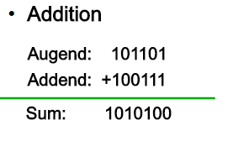
Half Adder (HA)
Half adder is a combinational logic circuit with two inputs and two outputs.
The half adder circuit is designed to add two single bit binary numbers
It is the basic building block for addition of two single bit numbers. This circuit has two outputs carry and sum.

Slide 5
Half Adder (1-bit)
A
B
A | B | S(um) | C(arry)
0 | 0 | 0 | 0
0 | 1 | 1 | 0
1 | 0 | 1 | 0
1 | 1 | 0 | 1
Half
Adder
S
C

Slide 6
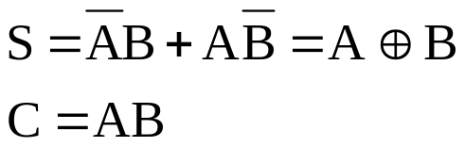
Half Adder (1-bit)
A | B | S(um) | C(arry)
0 | 0 | 0 | 0
0 | 1 | 1 | 0
1 | 0 | 1 | 0
1 | 1 | 0 | 1
A
Sum
B
Carry

Slide 7
Limitations (disadvantages) of half-adder:
  In multi-digit addition we have to add two bits along with the carry of previous digit addition. Such addition requires addition of 3 bits. This is not possible in half-adders.

Slide 8
Full Adder
Full adder is developed to overcome the drawbacks of Half Adder circuit.
It can add two one-bit numbers A and B, and carry C.
The full adder is a three input and two output combinational circuit.

Slide 9
Full Adder
A
B
Cin | A | B | S(um) | Cout
0 | 0 | 0 | 0 | 0
0 | 0 | 1 | 1 | 0
0 | 1 | 0 | 1 | 0
0 | 1 | 1 | 0 | 1
1 | 0 | 0 | 1 | 0
1 | 0 | 1 | 0 | 1
1 | 1 | 0 | 0 | 1
1 | 1 | 1 | 1 | 1
Full
Adder
S
Carry In
(Cin)
Cout

Slide 10
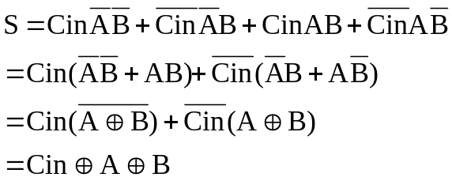

Full Adder
Cin | A | B | S(um) | Cout
0 | 0 | 0 | 0 | 0
0 | 0 | 1 | 1 | 0
0 | 1 | 0 | 1 | 0
0 | 1 | 1 | 0 | 1
1 | 0 | 0 | 1 | 0
1 | 0 | 1 | 0 | 1
1 | 1 | 0 | 0 | 1
1 | 1 | 1 | 1 | 1
AB
Cin
 | 00 | 01 | 11 | 10
0 | 0 | 1 | 0 | 1
1 | 1 | 0 | 1 | 0
AB
AB
Cin
 | 00 | 01 | 11 | 10
0 | 0 | 0 | 1 | 0
1 | 0 | 1 | 1 | 1
Cin
 | 00 | 01 | 11 | 10
0 | 0 | 0 | 1 | 0
1 | 0 | 1 | 1 | 1
Or

Slide 11


Full Adder
H.A.
H.A.
A
B
S
Cin
Cout

Slide 12
Full Adder
A
A
S
A
S
S
Half
Adder
Half
Adder
B
B
C
B
C
Cout
Cin

Slide 13
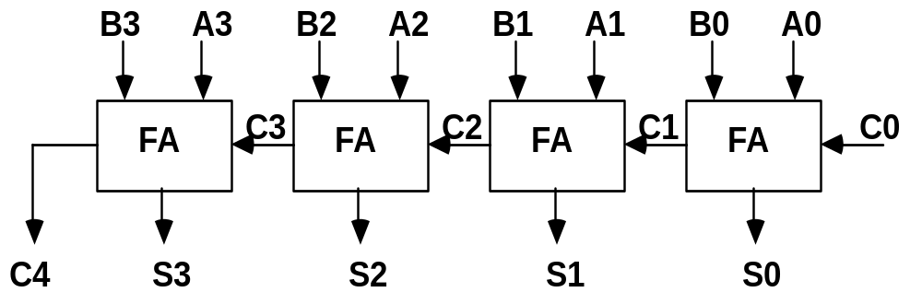
BINARY ADDER
Binary Adder

Slide 14
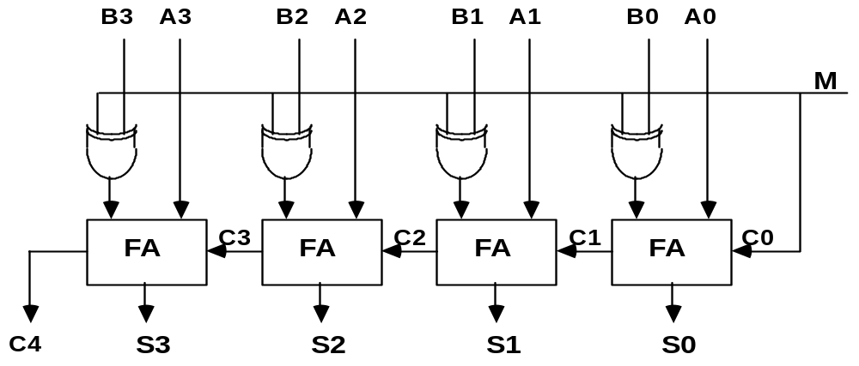
BINARY ADDER-SUBTRACTOR
Binary Adder-Subtractor

Slide 15
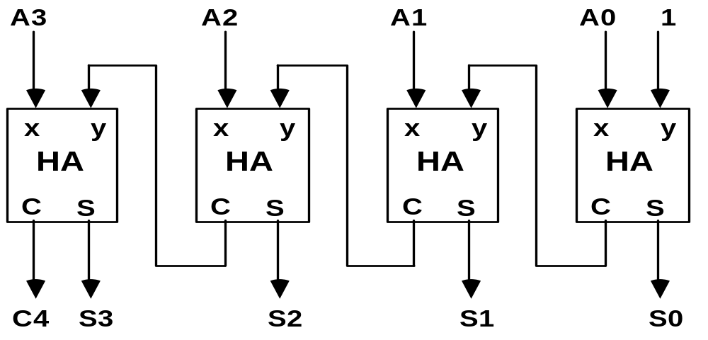
BINARY INCREMENTER
Binary Incrementer

